Slide 1
MEMS 101
By: Alex Drummond
Lab Partners: Seth Wills and Jarred Clark

Slide 2
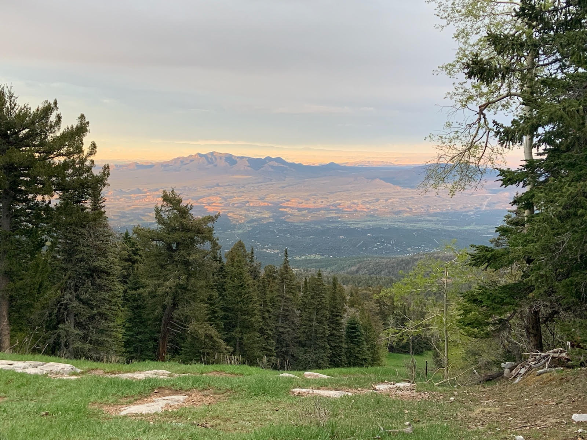
Clean Room Trip

Slide 3
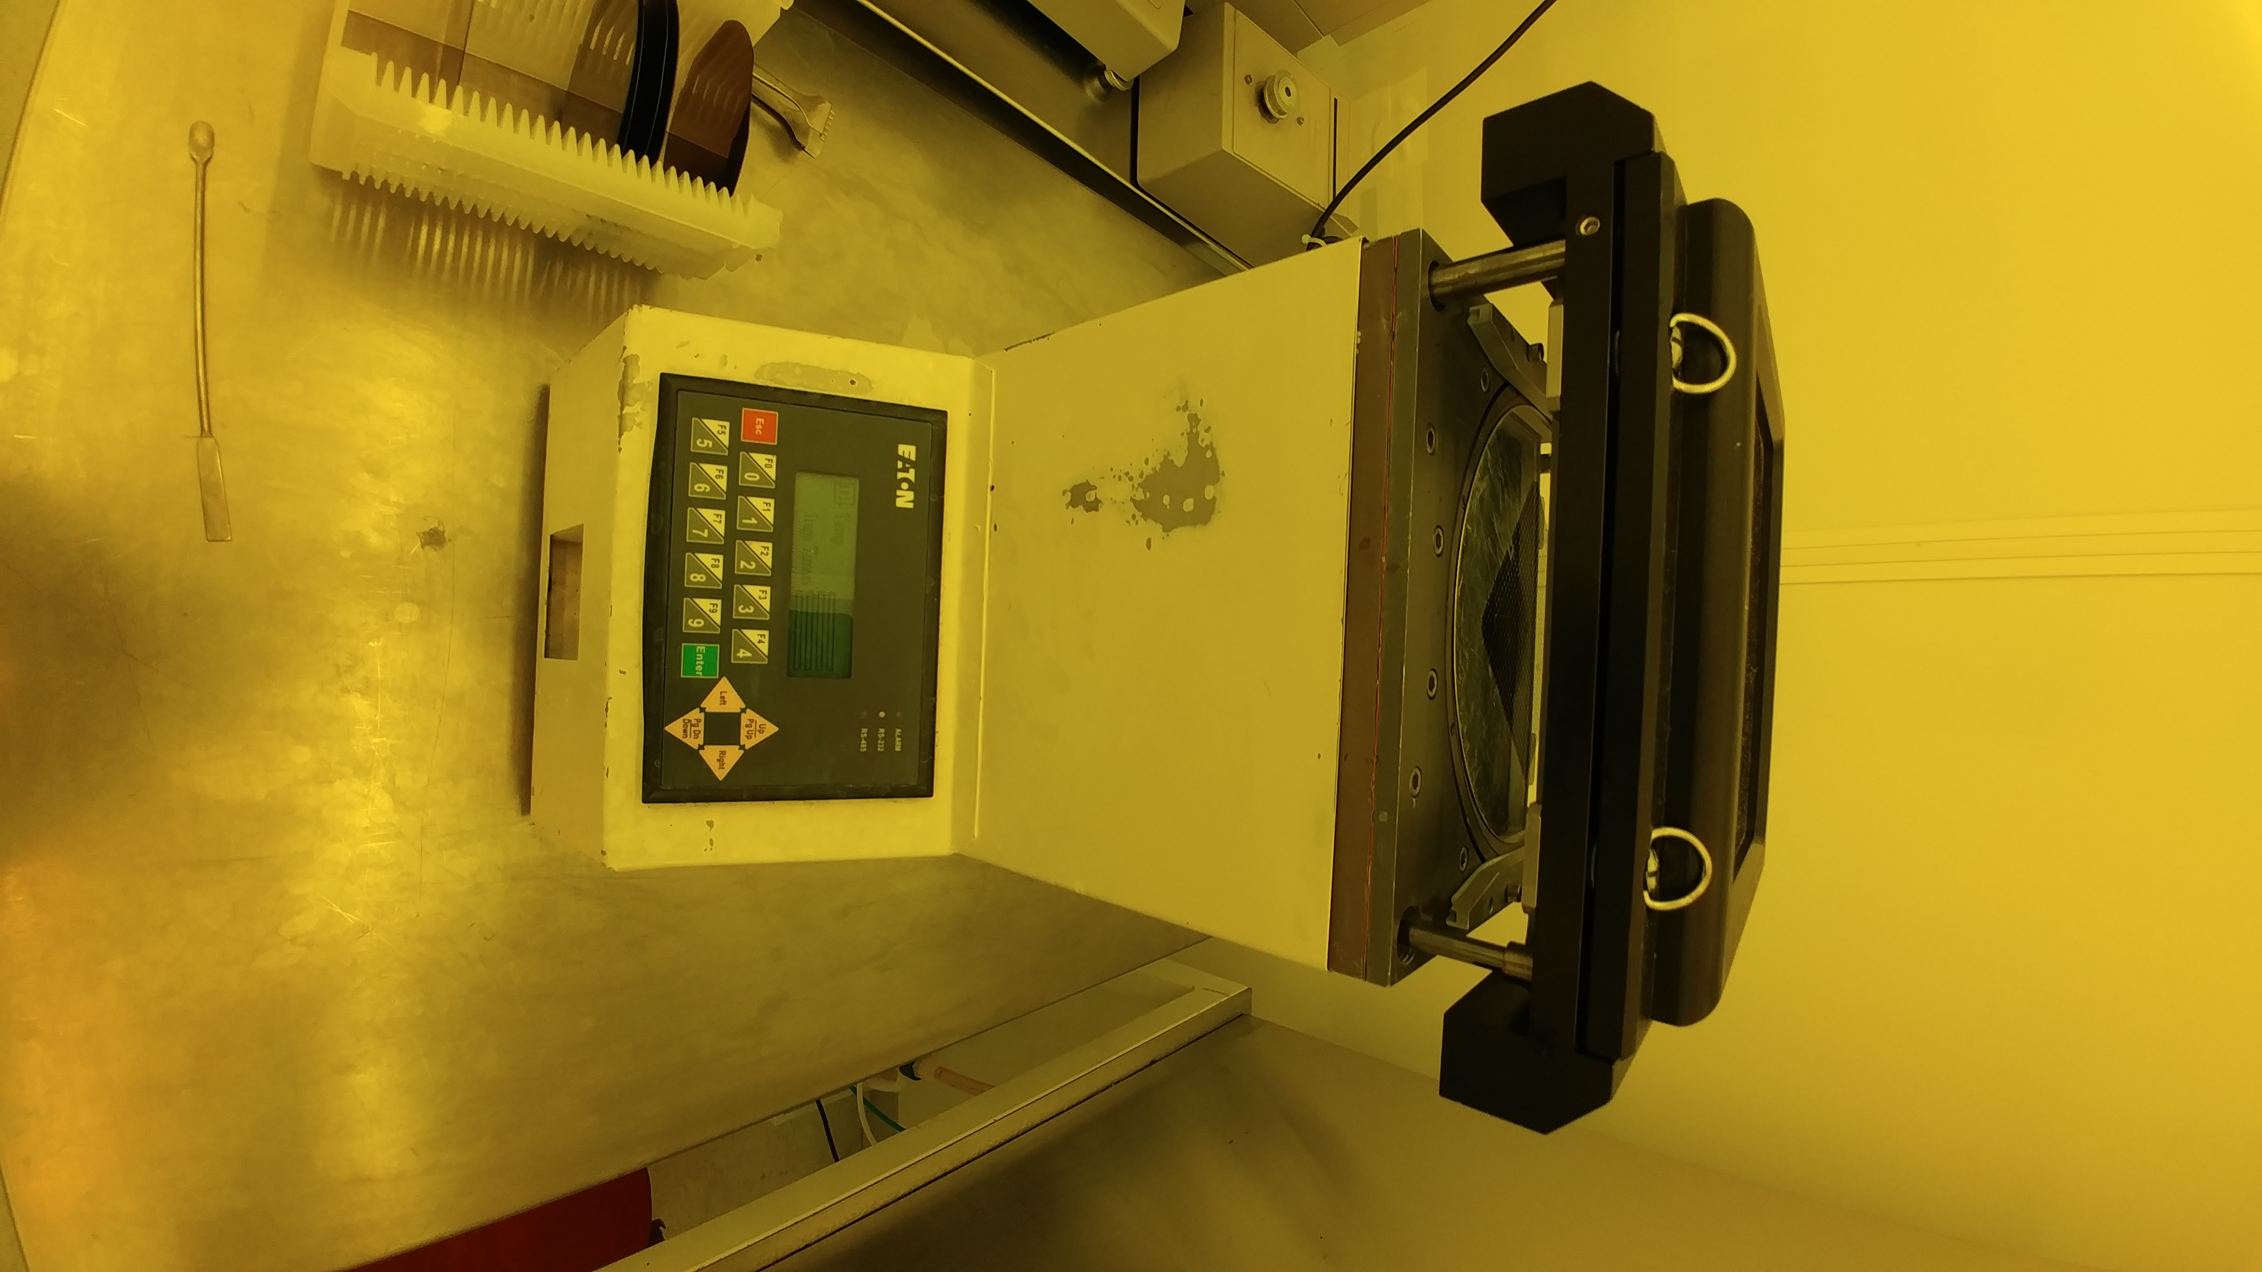
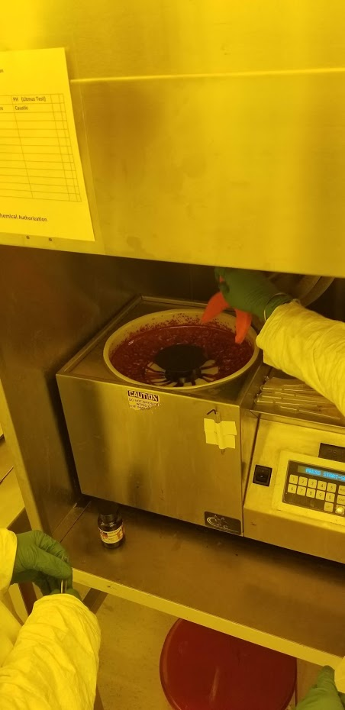
Clean Room Trip
This step made the wafer more hydroplyric
This step spins photoresist on to the wafer

Slide 4
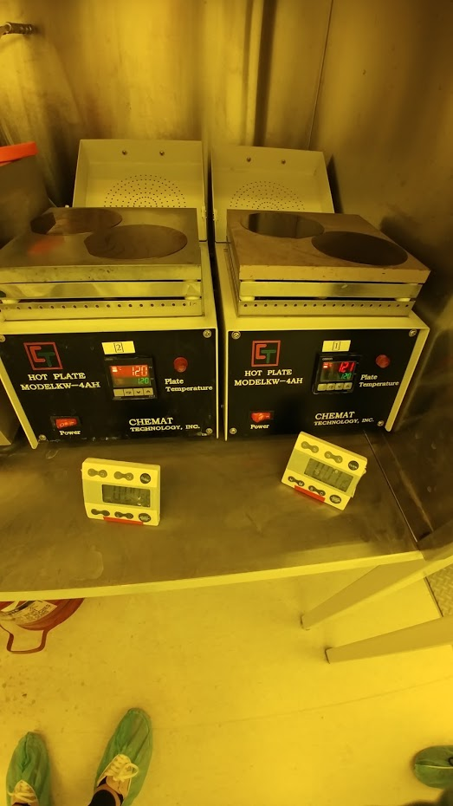
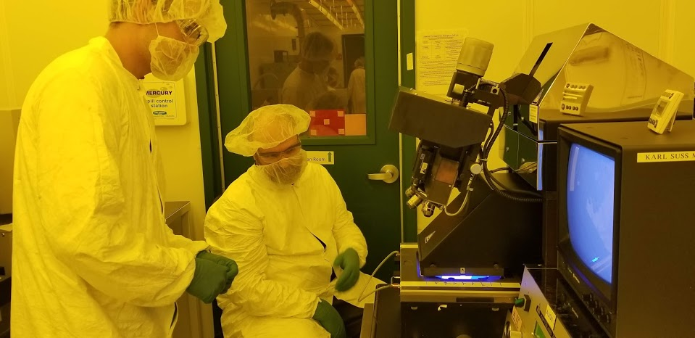
Clean Room Trip
This step was to set the photoresist on the wafer
This step was to print the pattern on the wafer using UV light

Slide 5
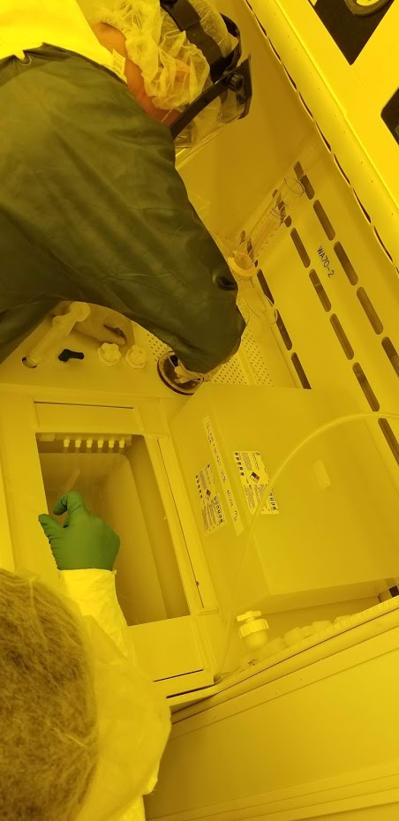
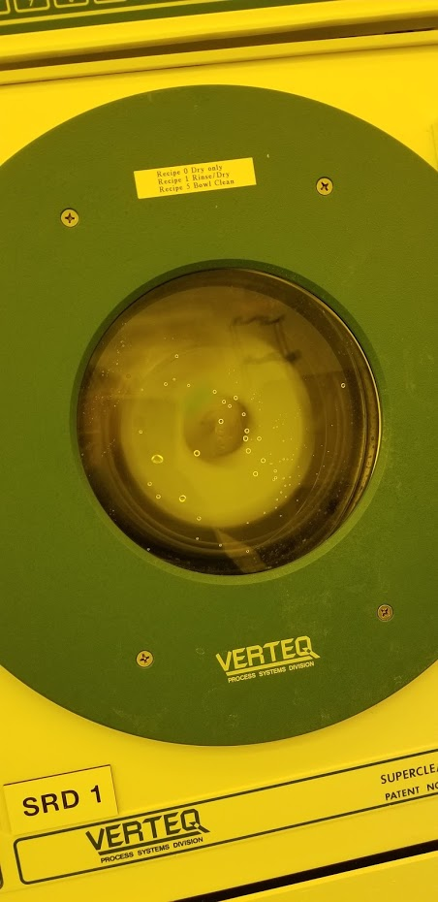
Clean Room Trip
These steps where to clean off the wafer and to dry spin the wafer after rinsing it off three times.

Slide 6
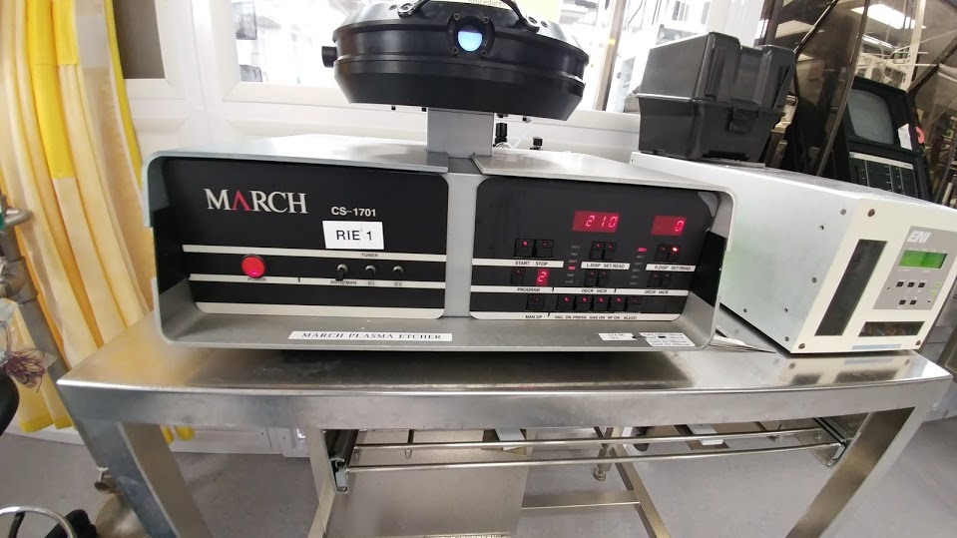
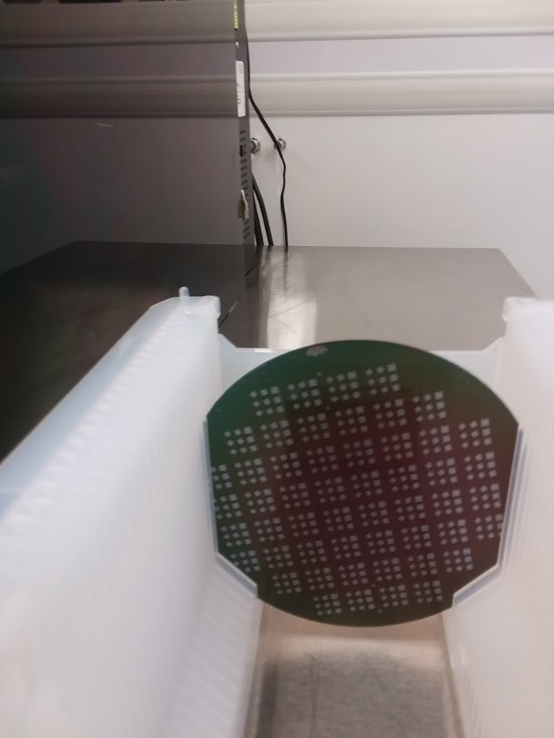
Clean Room Trip
This step etches the wafer for the membrane using plasma.

Slide 7
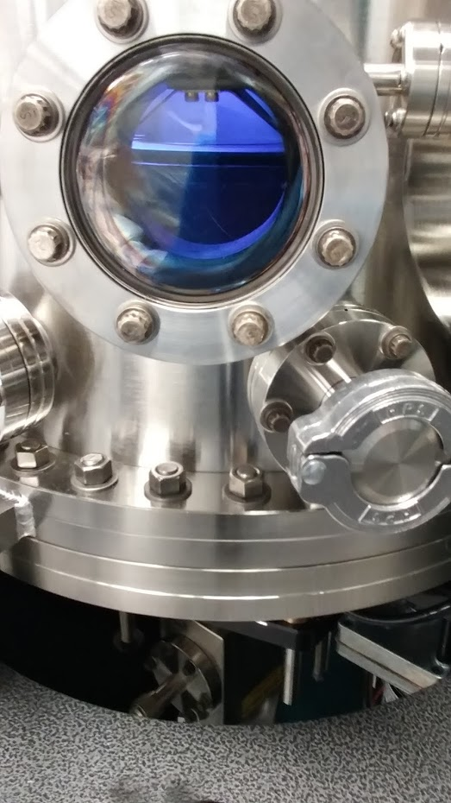
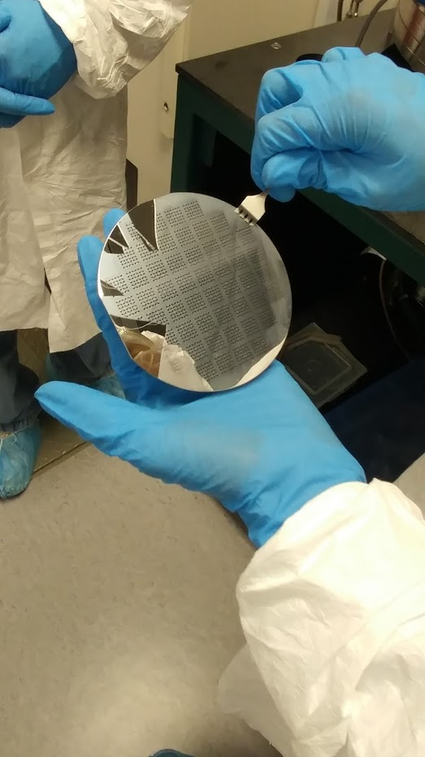
Clean Room Trip
This step adds chrome to the wafer also using plasma

Slide 8
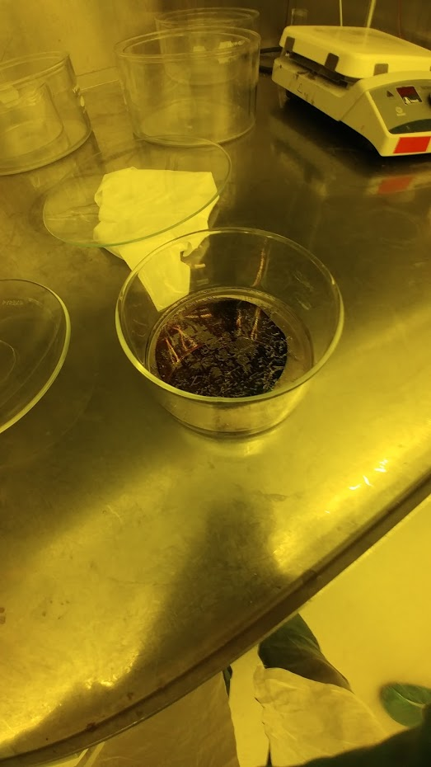
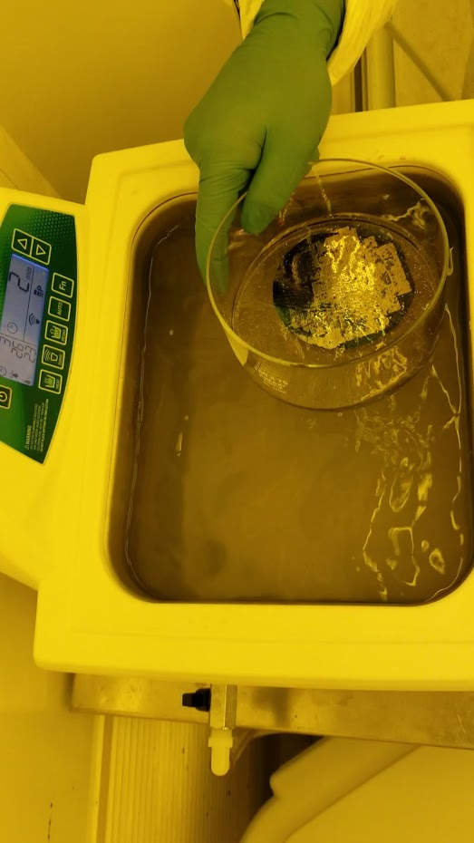
Clean Room Trip
This step removes the chrome from the wafer. The sonic wash removes the remaining chrome

Slide 9
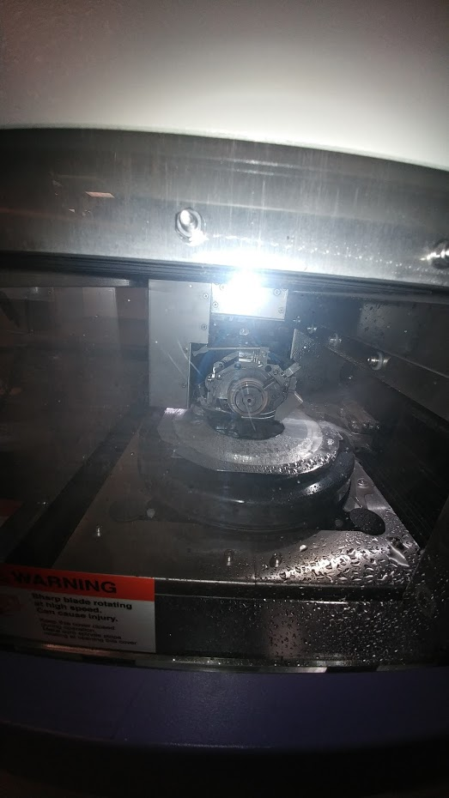
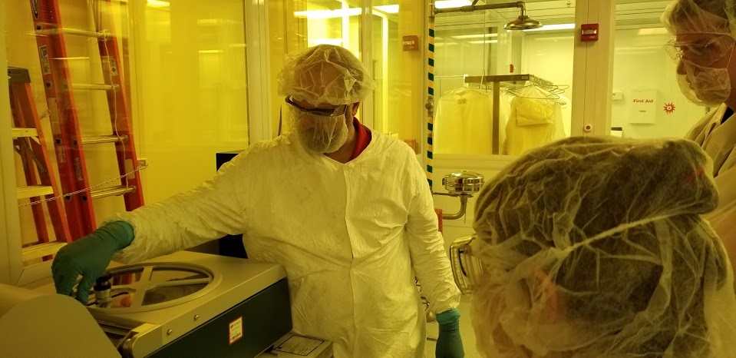
Clean Room Trip
This is the final step of the wafer. We dice the wafer and package the wafer.

Slide 10
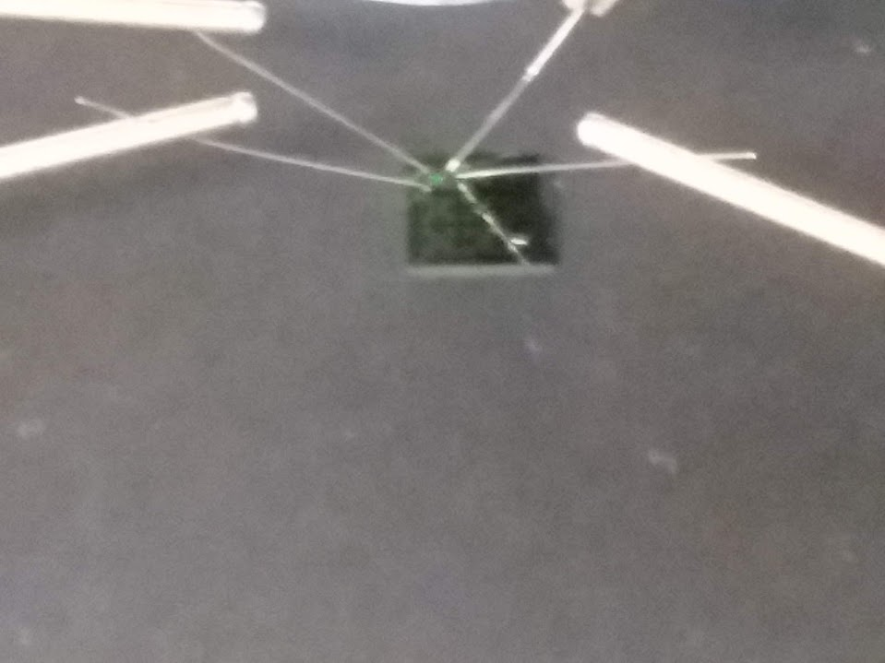
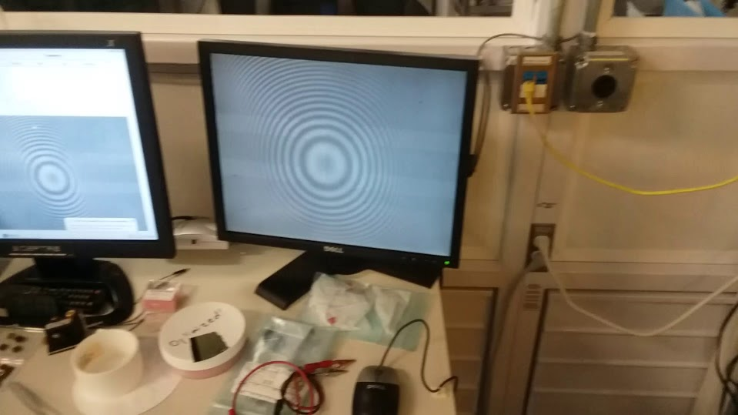
Clean Room Trip
This is testing a pressure sensor with four probes in the four corners. The more pressure you added the more the circle stretched out.

Slide 11
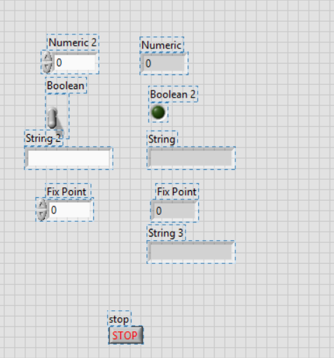
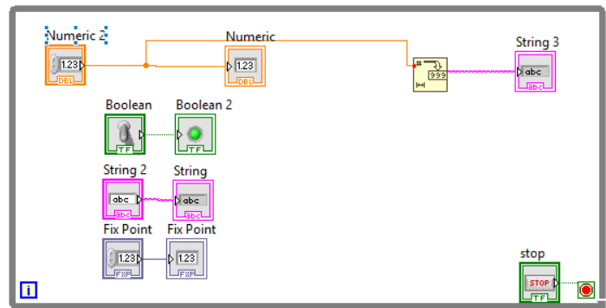
Week 2
Data Types
This program shows many different data types that you are able to use in LabVIEW. You have strings, numeric and Boolean

Slide 12
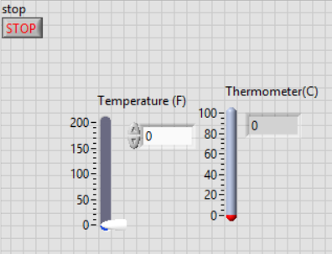
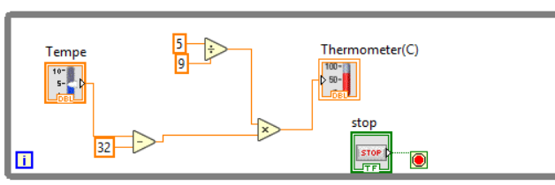
Data Flow
This program converts degree Fahrenheit to Celsius. When you change the slide for Fahrenheit it still coverts it into Celsius.

Slide 13
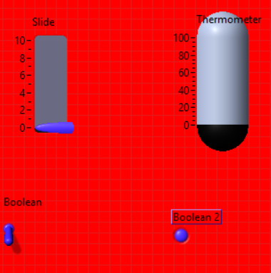
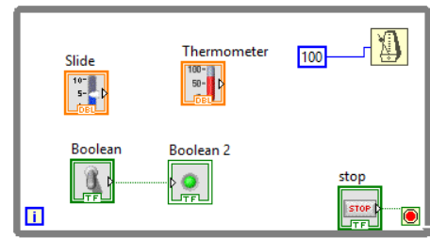
Using Tool Panel
All we did in this LabVIEW was mess with the tool panel to change the color of all the things

Slide 14
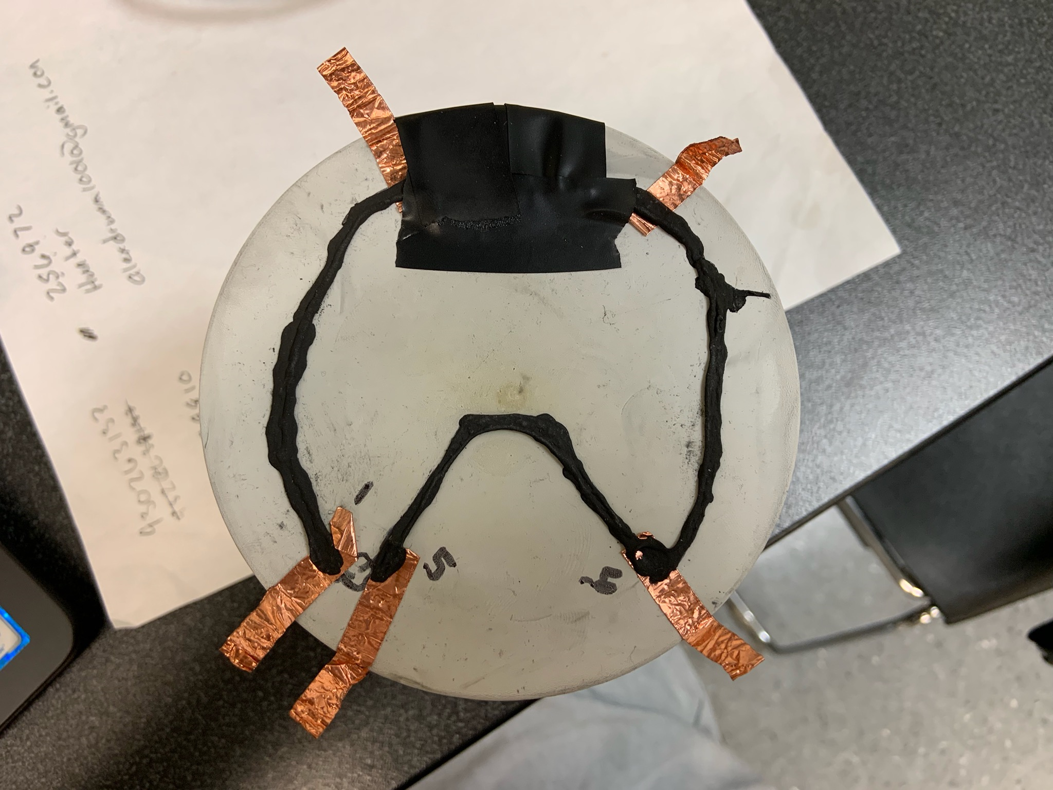
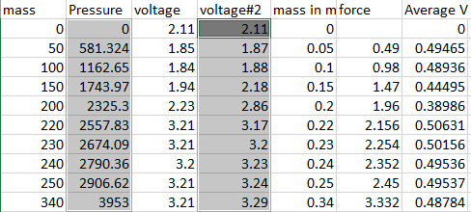
Week 3
Pressure Sensor Model
Lab Partners: Seth Wills and Jarred Clark
In week three we built a pressure sensor model. The we hooked up power to it and a multi-meter and recorded data using different mass

Slide 15
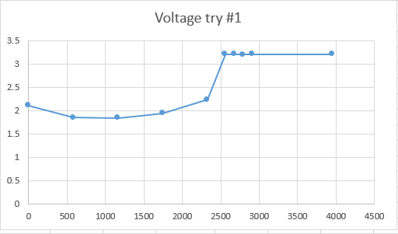
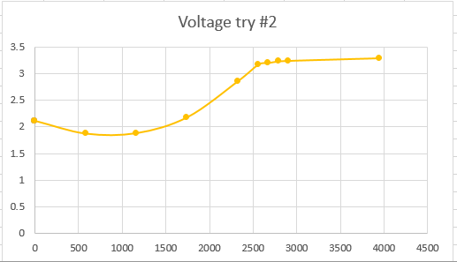
Pressure Sensor Model Graphs
This is the date of our first try. The Y axis is the voltage. While the X-axis is the mass
This is the date of our second try. The Y axis is the voltage. While the X-axis is the mass

Slide 16
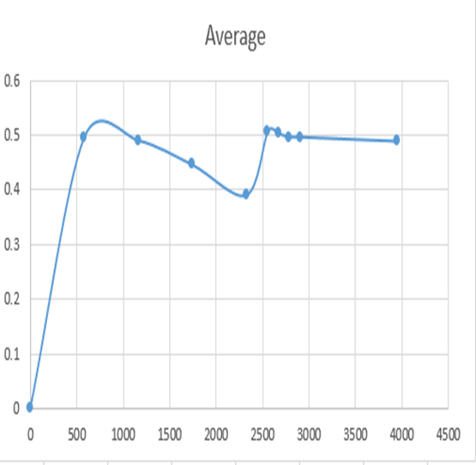
Pressure Sensor Model Average
This is the average of the data that we have collected. X- axis is average voltage and Y- axis is mass.

Slide 17
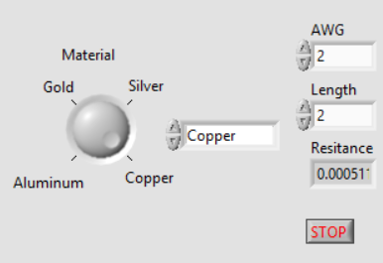
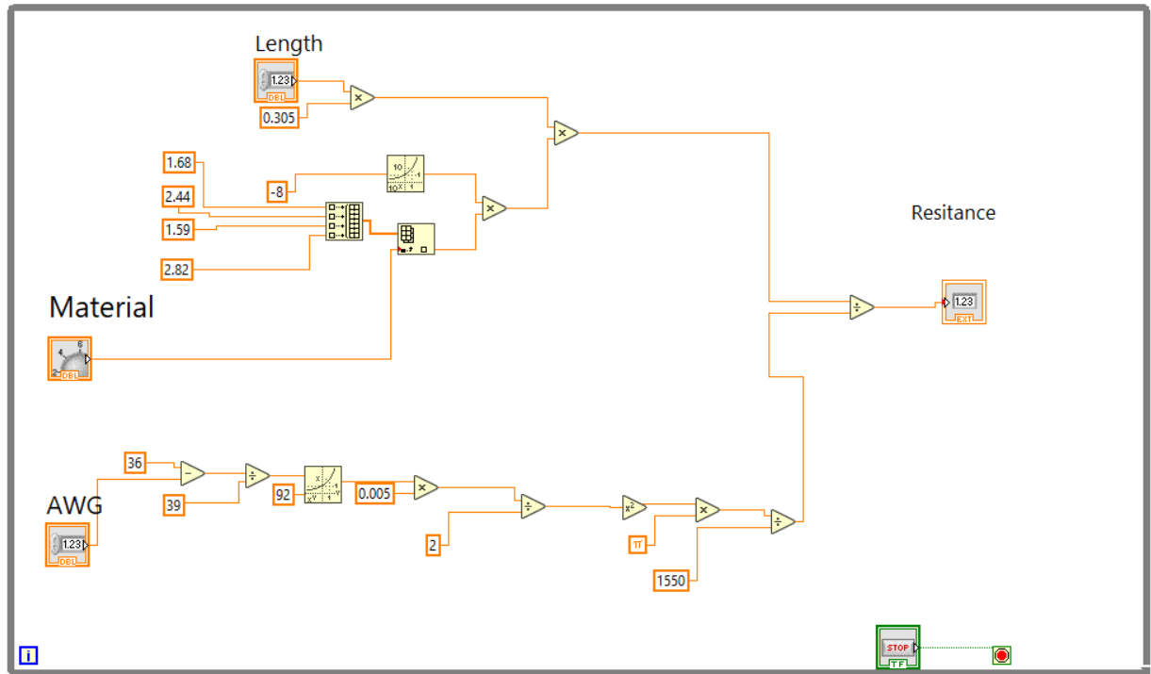
Week 4
Wire Resistance Program
This program calculates different wire resistance for 4 different materials, AWG and length.

Slide 18
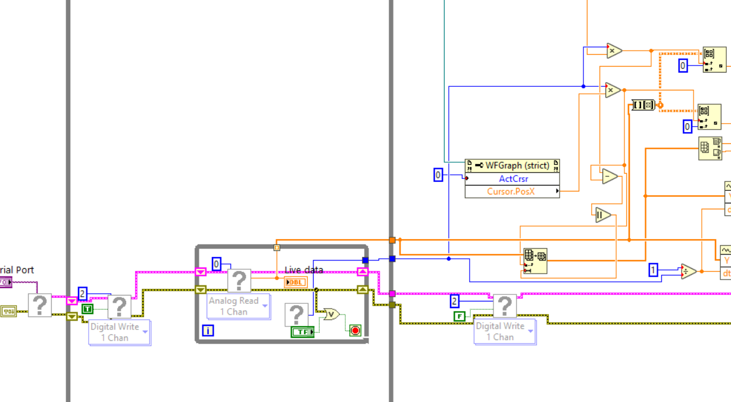
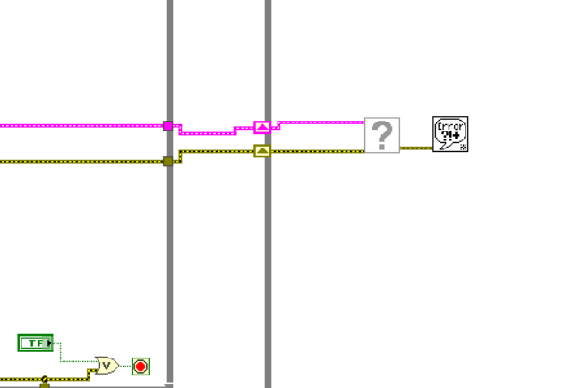
Week 4/Week 5
Does it Work
One of the problems that I have found is in the file DAC- DP Cantilever beam beta.vi . It has a problem looking for some sub-file. There are nine different files that are missing. To fix this you have to go in and replace them with what was originally there. That should fix the issue

Slide 19
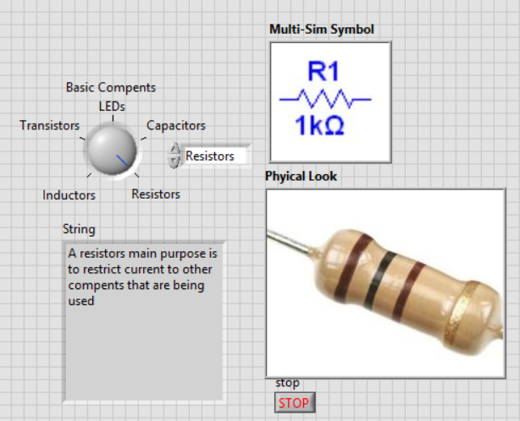
Week 7
Creating Our Own Program
I created a program that describes the basic components and shows the multi sim symbol for the component that is selected. I also added pictures of the physical components.

Slide 20
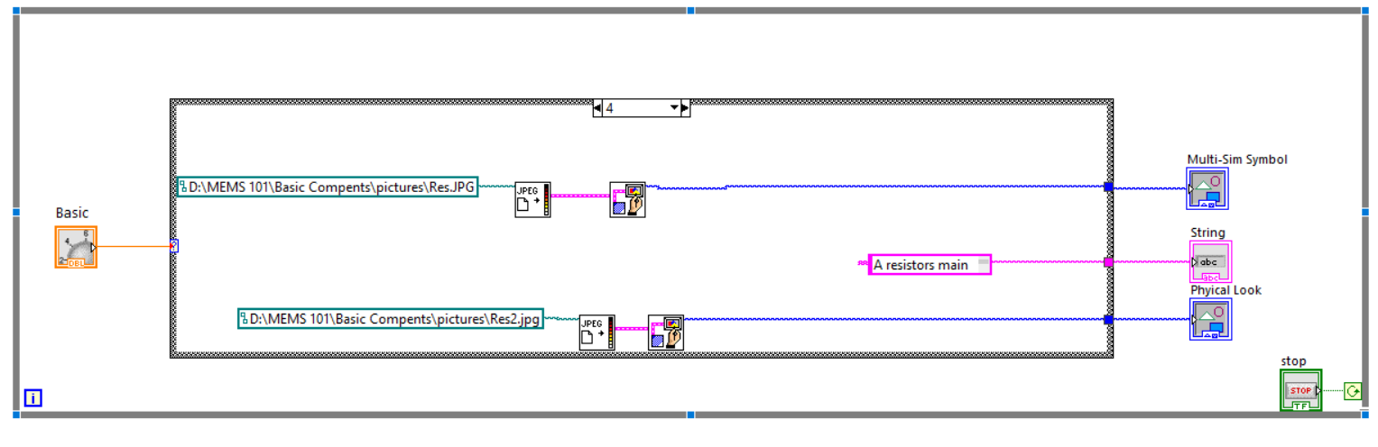
My Program Case Structure For Resistors

Slide 21
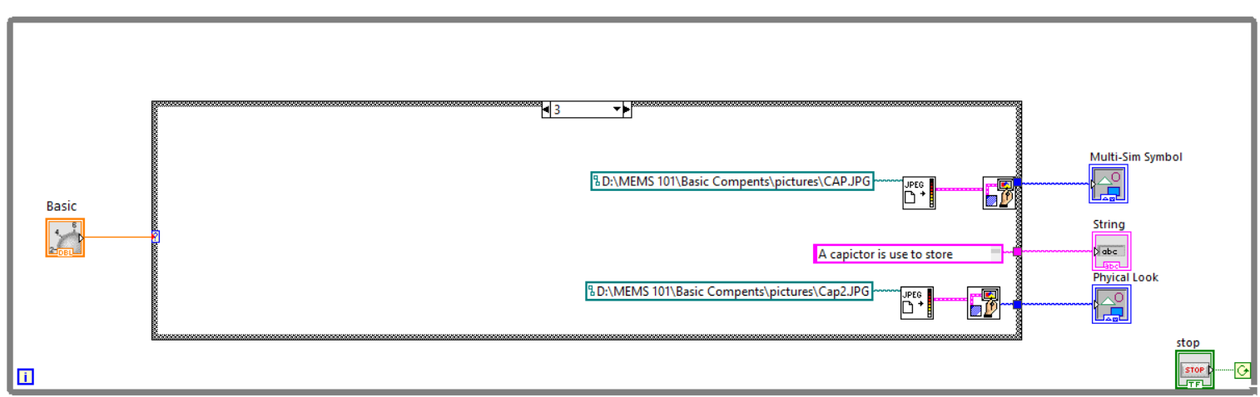
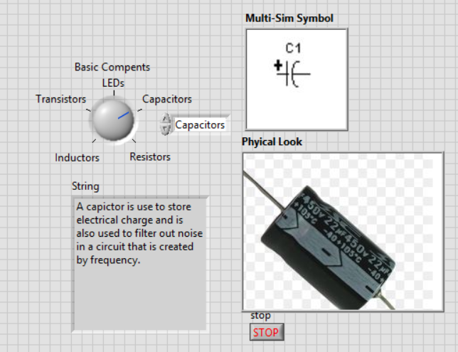
My Program
Capacitor

Slide 22
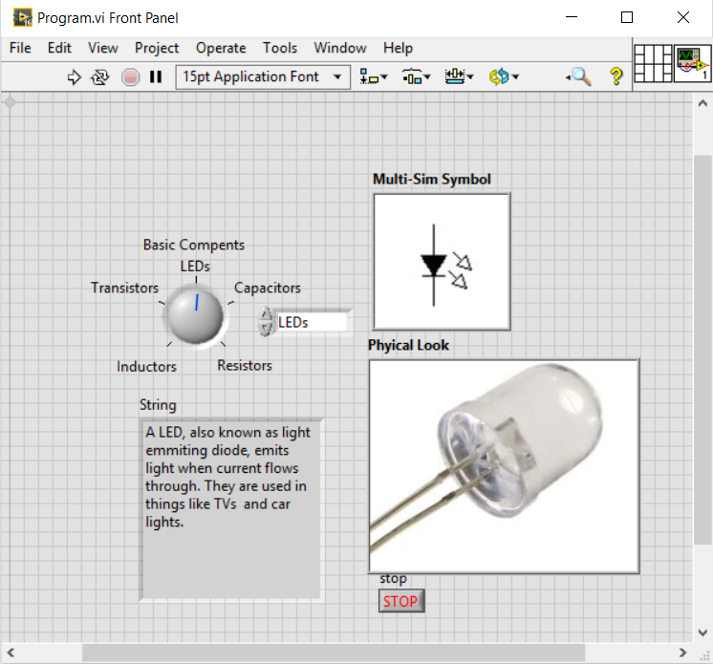
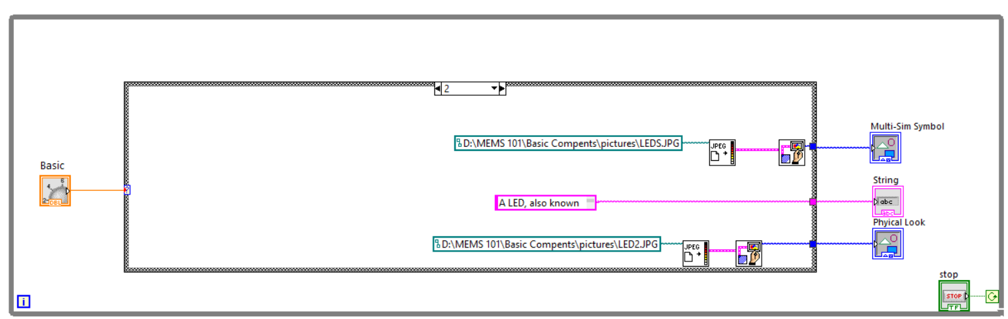
My Program
LEDs

Slide 23
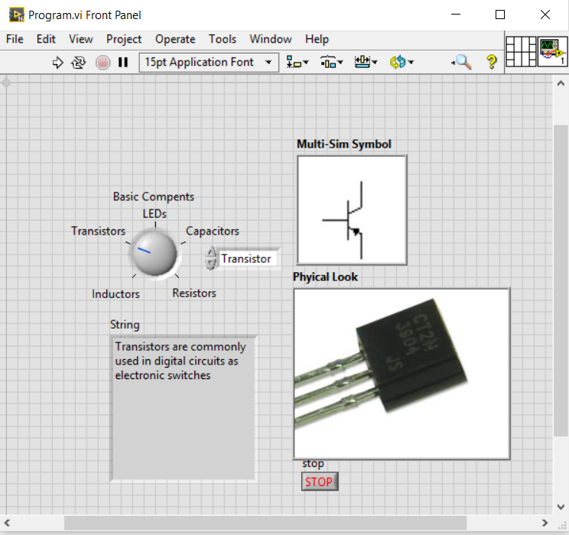
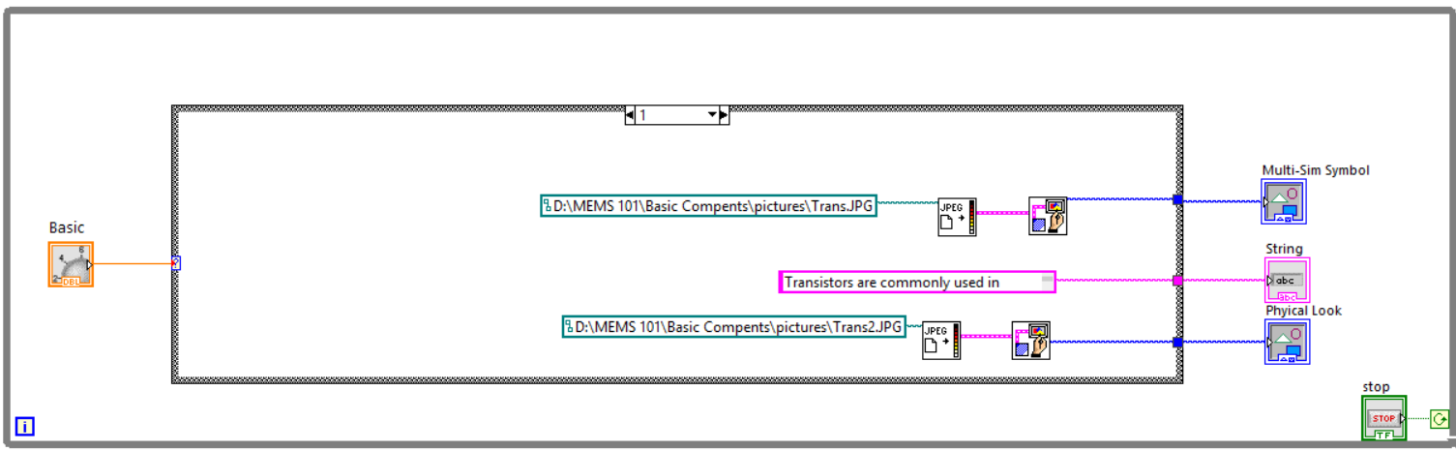
My Program
Transistor

Slide 24
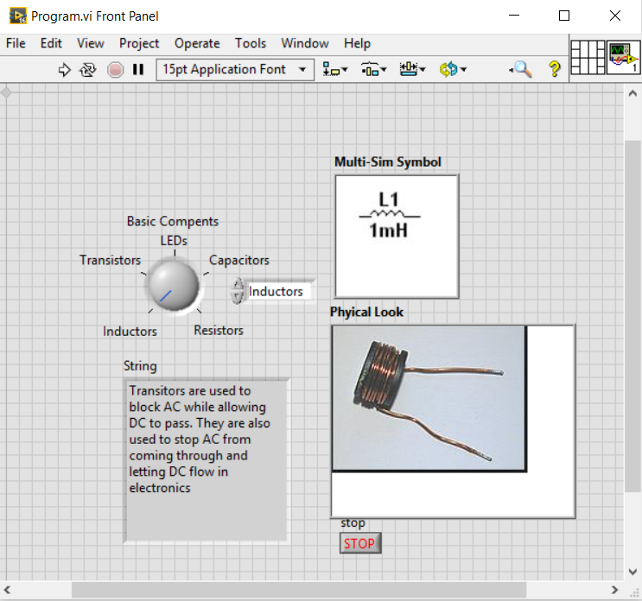
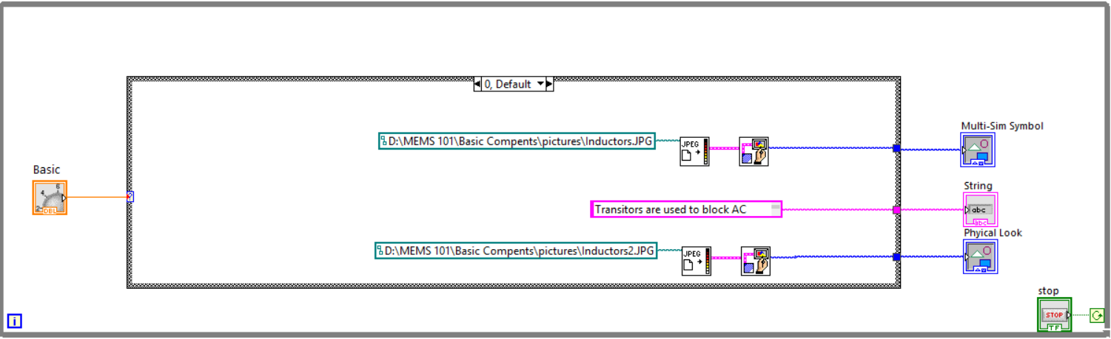
My Program
Inductors

